Slide 1

Data Structure and Algorithms (CS221) gg
Lecture 01
Said Nabi
said.nabi@giki.edu.pk
Faculty of Computer Science and engineering
Gik Institute Topi, Swabi

Slide 2
Introduction
Engr. Said Nabi

Slide 3
Introduction: Course Instructor
Introduction: Course Instructor
Education:
BSSE: UoM
MSSE: Comsats University Isamabad
Speciallization: e-Commerce Development,
MS Thesis: e-Commerce Product Recommendadtion Using Machine
Learning Algorithms
Practicle Experience:
Working as Freelancer since 2016
Become TRS in 2020 on Fiverr
Completed over 800+ Projects with 500+ 5 stars reviews
Created a store for my Client, made $100k sales a month

Slide 4
Instructor
Email: said.nabi@giki.edu.pk
Webpage: https://tecplace.net/
Office: S20
Telephone Extension: 2154
Office Hours:
Monday/Thursday 9:00 AM - 4:00 PM

Slide 5
Course TA
Still to be assigned
Never hesitate to contact TA or me whenever you have some problem
The worst question is the one that stays in your head unanswered.

Slide 6
Some Rules
There is only one rule that will make the rest of the rules
Raise your hand before asking any question and then WAIT for the permission
Never ever Miss a class
Never ever “sleep” in the class
Always communicate in the official communication language
Never even think about using mobile during the class

Slide 7
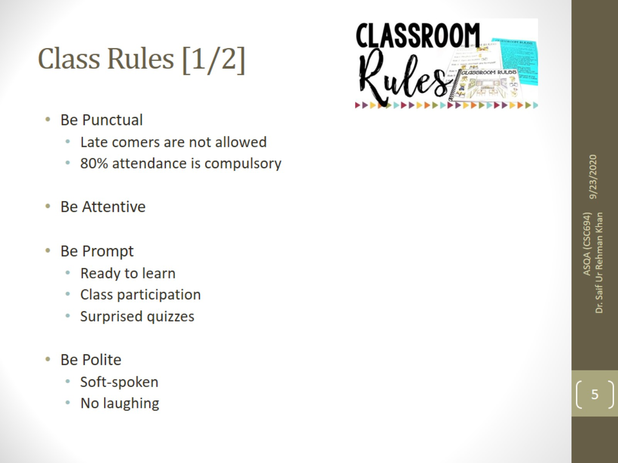
Class Rules [1/2]

Slide 8
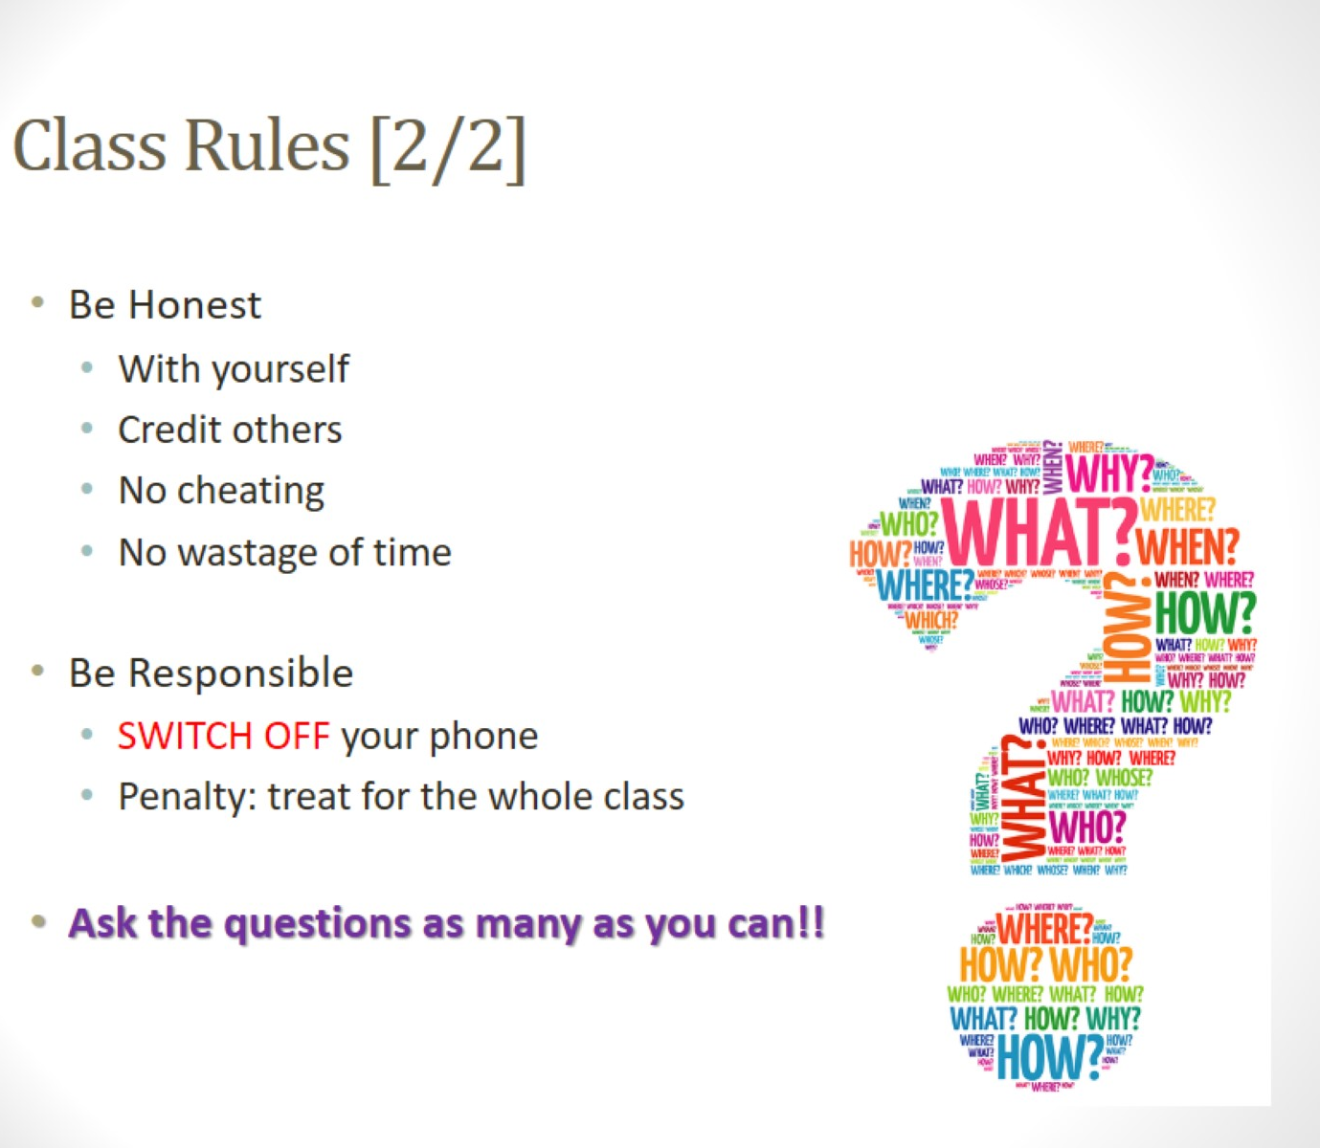
Class Rules [2/2]

Slide 9
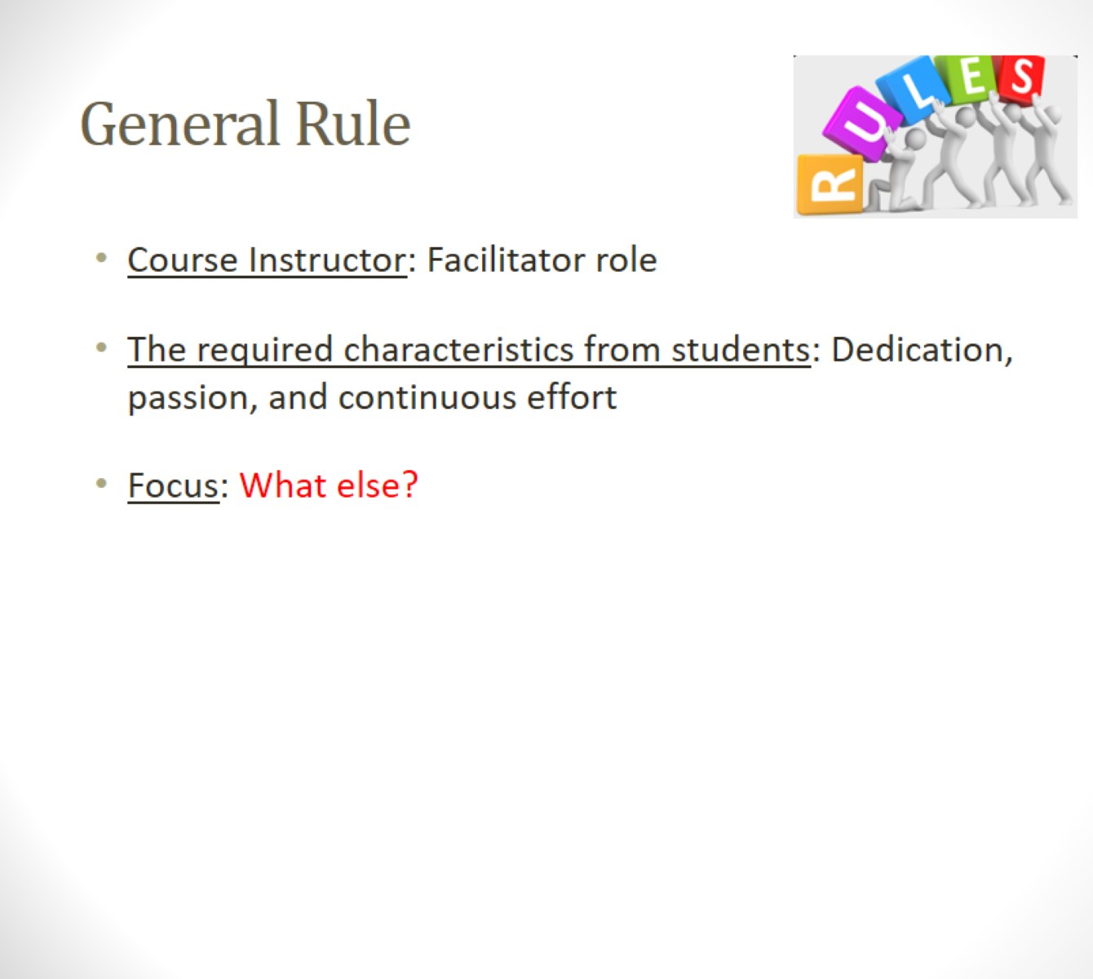
General Rule

Slide 10

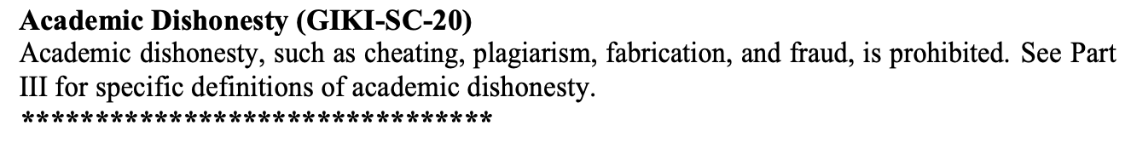
Dishonesty, Plagiarism in Quizzes, Assignments
All individuals involved in any kind of cheating in any exam, quiz, assignment or project will get -50% score.

Slide 11
Attendance
Students are required to attend 100% classes of courses registered and cannot abstain from even a single class.
For circumstances beyond their control, students must apply for leave on prescribed Leave Application form.

Slide 12
Quizzes
Announced
Unannounced

Slide 13
Tentative Evaluation Breakdown
Assignments (4) | 10
Quizzes (4) | 10
Term Project | 10
Midterm (1) | 30
Final (1) | 40
Total | 100

Slide 14
Course Execution
Three lectures of one hour every week
1 Lab of 3 hours
Course website: http://cms.giki.edu.pk
See schedule
Mind it: Lecture scheduling is to be done by the Dir. (A&E). Please avoid visiting me for any clashes

Slide 15
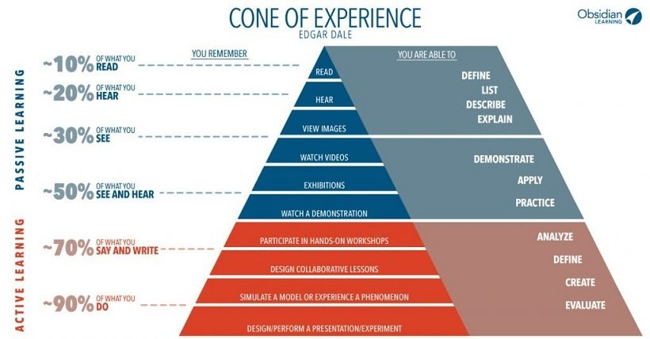
Remember

Slide 16
Outline
Introduction to the Course
Course Objectives
Why this course is important for you?
Course Contents and Structure
Course Project

Slide 17
Lecture Format
Start with Q & A
Main Lecture
No short breaks in the middle
Practice sessions on various problems

Slide 18
Course Outline
In this course you will learn
Introduction
Algorithm Analysis
Abstract Data Types (ADTs)
Lists, Stacks, and Queues
Trees
Hashing
Queues
Sorting
Graph Algorithms
Algorithm Design Techniques

Slide 19
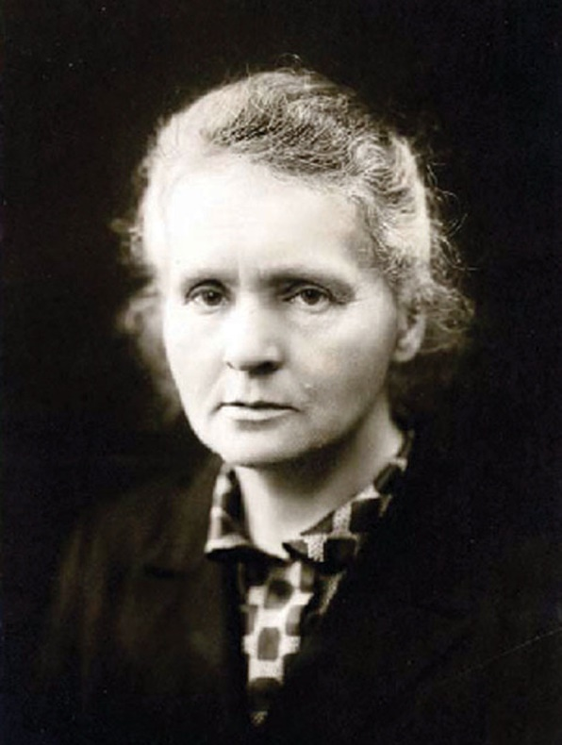
Motivation!
Nothing in life is to be feared, it is only to be understood.” – Marie Curie
DS & Algorithms = backbone of computing
Without them, even fast hardware is useless

Slide 20
What exactly data structures and algorithms are?

Slide 21
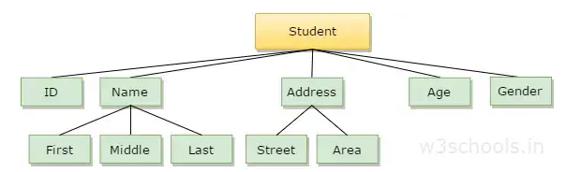
What is data?
Raw facts & figures
Represented in numbers, text, images
Organized = information

Slide 22

Real World Example
Let say you want to prepare Bana Milkshake for the first Time
You require a list of ingredients and a set of instructions presented in a comprehensible language that you can understand.
Ingredients: Data Structure
2 ripe bananas
1 cup of milk
1-2 tablespoons of sugar
Ice cubes
Instructions: Algorithm
Peel and chop the bananas.
Blend bananas, milk, sugar, and ice cubes until smooth.
Adjust sugar to taste.
Pour into glasses and enjoy!
ingredients + recipe = dish → data structure + algorithm = program.

Slide 23
Similarly in computer World: You need to provide instructions which computer can understand.
To perform a task:
Data Structure
Algorithm
Let say you want to add two numbers 7+5=?
Some mysterious
processing
Input
Output

Slide 24
What is a data structure?
In a general sense, any representation that is used for storing information is a data structure
Example: An integer, structures, classes, linked lists, etc
More typically, a data structure provides a way of organization for a collection of data items

Slide 25
Data Structure and algorithms
Data Sturcture: is the way to arange data in main memory (ram)
for efficient usage. (ingrediants)
Algorithm: is a sequance of steps to solve a given problem. As seen in afore mentioned example of preparing banana milkshake.
Examples: Arrays, Linklists Stack, Queue,Tree, Graphs

Slide 26
Where Data Structure is Helpful?
The choice of efficient data structure makes the difference between a program running in a few seconds or many days

Slide 27
Computer Based Example:
How to solve the following problems:
1. Input 3 numbers, print out the maximum.
2. Input 30000 numbers, print out the largest 10 numbers.

Slide 28
What is Data Structure Efficiency?
A solution is said to be efficient if it solves the problem within its resource constraints in a reasonable amount of time.
Space
Time
The cost of a solution is the amount of resources that the solution consumes.

Slide 29
Costs and Benefits
Each data structure has costs and benefits.
It is very difficult to find a data structure that is better than others in all situations.
A data structure requires:
space for each data item it stores,
time to perform each basic operation,
programming effort.

Slide 30
Goals of this Course
Learn the commonly used data structures.
These form a programmer's basic data structure “toolkit”
Case Studies of Data Structures.
We will examine the costs and benefits of every data structure or program.

Slide 31
Example
A cellular service company provides contracts to its 10 million users
Due to new security enforcements, the company wants to prevent issuing of multiple contracts to users
Method of Detecting Multiple Contracts
Before issuing a new contract to user
First search the id of user in existing contracts database
In case of failure, issue a new contract
In case of success, do not issue a new contract to user

Slide 32
Example
NIC# | Name | Address
6584495-9 | Muhammad Faheem | House No 3 Gulshan Bahar Sec 16
1748425-5 | Naeem Alam | A-11 Shams Plaza Block-B N.Nazimabad
0889679-1 | Arslan Akhtar | H No 152 Bostang Colony
3419668-1 | Zain Ahmed | Sharfabad Street Gulshan Karachi
3445864-3 | Sumair Farooq | Post Office Tayyar, Multan
6395653-4 | Ali Affan | H.No. 425, Sector F-11/4, Islamabad
8224641-1 | Syed Faraz | Sharfabad Street Gulshan, Faisalabad
Linear Array (with 10 million entries)
3 arrays (NIC, name, address),
structure array,
class’s object array

Slide 33
Example
New Contract
NIC# | Name | Address
6584495-9 | Muhammad Faheem | House No 3 Gulshan Bahar Sec 16
1748425-5 | Naeem Alam | A-11 Shams Plaza Block-B N.Nazimabad
0889679-1 | Arslan Akhtar | H No 152 Bostang Colony
3419668-1 | Zain Ahmed | Sharfabad Street Gulshan Karachi
3445864-3 | Sumair Farooq | Post Office Tayyar, Multan
6395653-4 | Ali Affan | H.No. 425, Sector F-11/4, Islamabad
8224641-1 | Syed Faraz | Sharfabad Street Gulshan, Faisalabad
Searching
Failure
Success
Issue
Not Issue
Any disadvantage of Linear Array (Data Structure)?
How to improve?

Slide 34
Example
Improved Data Structure
Create a dictionary data structure
Group all those records together that start with similar NIC (first digit) numbers, and add a dictionary entry for each distinct digit (0-9)
Example: 3419668-1, 3445864-3, 1748425-5.
3 and 1 are dictionary entries
In case of searching, first search the dictionary entry, and then proceed to searching contracts

Slide 35
Example
0
2
3
3
4
6
0
5
Dictionary
Array Elements
NIC# | Name | Address
6584495-9 | Muhammad Faheem | House No 3 Gulshan Bahar Sec 16
1748425-5 | Naeem Alam | A-11 Shams Plaza Block-B N.Nazimabad
0889679-1 | Arslan Akhtar | H No 152 Bostang Colony
3419668-1 | Zain Ahmed | Sharfabad Street Gulshan Karachi
3445864-3 | Sumair Farooq | Post Office Tayyar, Multan
6395653-4 | Ali Affan | H.No. 425, Sector F-11/4, Islamabad
8224641-1 | Syed Faraz | Sharfabad Street Gulshan, Faisalabad

Slide 36
Example
Another Data Structure
Maintain pointers with records
Non NULL pointer indicates presence of next record
NIC# | Name | Address
6584495-9 | Muhammad Faheem | House No 3 Gulshan Bahar Sec 16
1748425-5 | Naeem Alam | A-11 Shams Plaza Block-B N.Nazimabad
0889679-1 | Arslan Akhtar | H No 152 Bostang Colony
3419668-1 | Zain Ahmed | Sharfabad Street Gulshan Karachi
3445864-3 | Sumair Farooq | Post Office Tayyar, Multan
6395653-4 | Ali Affan | H.No. 425, Sector F-11/4, Islamabad
8224641-1 | Syed Faraz | Sharfabad Street Gulshan, Faisalabad
0
3
6
Dictionary

Slide 37
Data structures let the input and output be represented
in a way that can be handled efficiently and effectively.
array
Linked list
queue
tree
stack

Slide 38
Definition
Data may be organized in different ways
Data structure is the logical or mathematical model of a particular organization of data
Must be rich enough to mirror the actual relationships of the data in the real-world sample

Slide 39
Arrays
1 | Ali
2 | Salam
3 | Usman
4 | Danial
5 | Saeed
6 | Zaka
Liner Arrays

Slide 40
Link List
Jamal | 1
Sana | 1
 |  | Saeed | 2
Farooq | 3
Salman | 3 |  | Salman | 3

Slide 41
Trees
Employee
Name
Age
Address
Salary
First N
Last N
Street
Area
City
Province
Post Code

Slide 42
Trees
(2x+y)(a-7b)³
*
+
^
*
y
-
3
2
x
a
*
7
b

Slide 43
Stacks
2132
123
123
123
123
123
123
546
45
543
3
3
2544
IN
OUT

Slide 44
Queue
2132
123
123
123
123
123
3
3
2544
33
IN
OUT

Slide 45
The Need for Data Structures
Goal: to organize data
Criteria: to facilitate efficient
storage of data
retrieval of data
manipulation of data
Design Issue:
select and design appropriate data types. (This is the real essence of OOP.)

Slide 46
Data Structure Operations
Insertion
Deletion
Update
Searching
Sorting
Merging

Slide 47
Abstract Data Types
Abstract Data Type (ADT): a definition for a data type solely in terms of a set of values and a set of operations on that data type.
Each ADT operation is defined by its inputs and outputs.
Hide Implementation details

Slide 48
Abstract Data Types
Def.
a collection of related data items
together with
an associated set of operations
e.g. whole numbers (integers)
Basic Operations: apply arithmetic operations (addition, subtraction, multiplication and division)
e.g. Flight reservation (seats) Basic Operations: find empty seat, reserve a seat, cancel a seat assignment
Why "abstract" ?
Data, operations, and relations are studied independent of implementation.
What not how is the focus.

Slide 49
Data Structure
A data structure is the physical implementation of an ADT.
Each operation associated with the ADT is implemented by one or more subroutines in the implementation.
Data structure usually refers to an organization of data in main memory.
File structure is an organization for data on peripheral storage, such as a disk drive.

Slide 50
Boolean data
ADT’s for Primitive Data Types
Data values: {false, true}
Operations: and &&
or ||
not !
&&
| |
0 | 0 | 0
1 | 1 | 1
1 | 0 | 0
0 | 0 | 0
0 | 1 | 1
1 | 1 | 1
x !x
0 1
1 0

Slide 51




Character Data
Store numeric codes (ASCII, EBCDIC, Unicode)
1 byte for ASCII and EBCDIC,
2 bytes for Unicode
ASCII/EBCDIC
Unicode
Basic operation: comparison to determine if
Equal, Less than
,
Greater
than
, etc. use their numeric codes (i.e. use ordinal value)

Slide 52
Integer Data
Non-negative (unsigned) integer:
Store its base-two representation in a fixed number w of bits
(e.g., w = 16 or w = 32)
88 =
0000000001011000₂
Signed integer:
Store in a fixed number w of bits using complement representations:
Operations: arithmetic operators for addition, subtraction, multiplication and division

Slide 53
Time Complexity

Slide 54
Algorithm
Finite sequence of instructions.
An input should not take the program in an infinite loop
Each instruction having a clear meaning.
Very subjective. What is clear to me, may not be clear to you.
Each instruction requiring finite amount of effort.
Very subjective. Finite on a supercomputer or microcomputer?
Each instruction requiring finite time to complete.
Very subjective. 1 min, 1 hr, 1 year or a lifetime?

Slide 55
Algorithm Definition
A finite set of statements that guarantees an optimal solution in finite interval of time

Slide 56
Good Algorithms?
Run in less time
Consume less memory
But computational resources (time complexity) is usually more important

Slide 57
Measuring Efficiency
The efficiency of an algorithm is a measure of the amount of resources consumed in solving a problem of size n.
The resource we are most interested in is time
We can use the same techniques to analyze the consumption of other resources, such as memory space.
It would seem that the most obvious way to measure the efficiency of an algorithm is to run it and measure how much processor time is needed
Is it correct

Slide 58
Factors
Hardware
Operating System
Compiler
Size of input
Nature of Input
Algorithm
Which one should be improved?

Slide 59
Running Time of an Algorithm
Depends upon
Input Size
Nature of Input
Generally time grows with size of input, so running time of an algorithm is usually measured as function of input size.
Running time is measured in terms of number of steps/primitive operations performed
Independent from machine, OS

Slide 60
Finding running time of an Algorithm / Analyzing an Algorithm
Running time is measured by number of steps/primitive operations performed
Steps means elementary operation like
,+, *,<, =, A[i] etc
We will measure number of steps taken in term of size of input

Slide 61
Simple Example (1)
// Input: int A[N], array of N integers
// Output: Sum of all numbers in array A
int Sum(int A[], int N)
{
int s=0;
for (int i=0; i< N; i++)
s = s + A[i];
return s;
}
How should we analyse this?

Slide 62
Simple Example (2)
// Input: int A[N], array of N integers
// Output: Sum of all numbers in array A
int Sum(int A[], int N){
int s=0;
for (int i=0; i< N; i++)
s = s + A[i];
return s;
}
1
2
3
4
5
1,2,8: Once
3,4,5,6,7: Once per each iteration
of for loop, N iteration
Total: 5N + 3
The complexity function of the
algorithm is : f(N) = 5N +3
6
7
8

Slide 63
Simple Example (3) Growth of 5n+3
Estimated running time for different values of N:
N = 10 => 53 steps
N = 100 => 503 steps
N = 1,000 => 5003 steps
N = 1,000,000 => 5,000,003 steps
As N grows, the number of steps grow in linear proportion to N for this function “Sum”

Slide 64
What Dominates in Previous Example?
What about the +3 and 5 in 5N+3?
As N gets large, the +3 becomes insignificant
5 is inaccurate, as different operations require varying amounts of time and also does not have any significant importance
What is fundamental is that the time is linear in N. Asymptotic Complexity: As N gets large, concentrate on the highest order term:
Drop lower order terms such as +3
Drop the constant coefficient of the highest order term i.e. N

Slide 65
Be careful to differentiate between
Performance: how much time/memory/disk/... is actually used when a program is run. This depends on the machine, compiler, etc. as well as the code.
Complexity: how do the resource requirements of a program or algorithm scale, i.e., what happens as the size of the problem being solved gets larger.

Slide 66











Asymptotic Complexity
The 5N+3 time bound is said to "grow asymptotically" like N
This gives us an approximation of the complexity of the algorithm
Ignores lots of (machine dependent) details, concentrate on the bigger picture
O(n!)
O(n³)
O(n²)
O(n log n)
O(n)
Operations
O(log n)
O(1)
Input

Slide 67
Comparing Functions: Asymptotic Notation
Big Oh Notation: Upper bound
Omega Notation: Lower bound
Theta Notation: Tighter bound

Slide 68
Example : Comparing Functions
Which function is better?
10 n² Vs n³

Slide 69
Comparing Functions
As inputs get larger, any algorithm of a smaller order will be more efficient than an algorithm of a larger order
0.05 N² = O(N²)
3N = O(N)
Time (steps)
N = 60
Input (size)

Slide 70
Big-Oh Notation
Big O notation is a mathematical concept in computer science used to describe how an algorithm's time or space requirements grow as the input size increases.
Simple Rule:
Drop lower order terms and constant factors
7n-3 is O(n)
8n²log n + 5n² + n is O(n²log n)

Slide 71
Performance Classification
f(n) | Classification
1 | Constant: run time is fixed, and does not depend upon n. Most instructions are executed once, or only a few times, regardless of the amount of information being processed
log n | Logarithmic: when n increases, so does run time, but much slower. Common in programs which solve large problems by transforming them into smaller problems.
n | Linear: run time varies directly with n. Typically, a small amount of processing is done on each element.
n log n | When n doubles, run time slightly more than doubles. Common in programs which break a problem down into smaller sub-problems, solves them independently, then combines solutions
n² | Quadratic: when n doubles, runtime increases fourfold. Practical only for small problems; typically the program processes all pairs of input (e.g. in a double nested loop).
n³ | Cubic: when n doubles, runtime increases eightfold
2^{n} | Exponential: when n doubles, run time squares. This is often the result of a natural, “brute force” solution.
Notes:
N log n :- Merge Sort Quick Sort
Bubble Sort / Insertion Sort / Selection Sort
Matrix Multiplication

Slide 72
Size is important
What happens if we double the input size N?
N log₂N 5N N log₂N N² 2^{N}
8 3 40 24 64 256
16 4 80 64 256 65536
32 5 160 160 1024 ~10⁹
64 6 320 384 4096 ~10¹⁹
128 7 640 896 16384 ~10³⁸
256 8 1280 2048 65536 ~10⁷⁶

Slide 73
Size is Important
Suppose a program has run time O(n!) and the run time for
n = 10 is 1 second
For n = 12, the run time is 2 minutes
For n = 14, the run time is 6 hours
For n = 16, the run time is 2 months
For n = 18, the run time is 50 years
For n = 20, the run time is 200 centuries

Slide 74
Constant time statements
Simplest case: O(1) time statements
Assignment statements of simple data types int x = y;
Arithmetic operations: x = 5 * y + 4 - z;
Array referencing: A[j] = 5;
Array assignment: ∀ j, A[j] = 5;
Most conditional tests: if (x < 12) ...

Slide 75
Analyzing Loops
Any loop has two parts:
How many iterations are performed?
How many steps per iteration?
int sum = 0,j;
for (j=0; j < N; j++)
sum = sum +j;
Loop executes N times (0..N-1)
4 = O(1) steps per iteration
Total time is N * O(1) = O(N*1) = O(N)

Slide 76
Analyzing Loops
What about this for loop?
int sum =0, j;
for (j=0; j < 100; j++)
sum = sum +j;
Loop executes 100 times
4 = O(1) steps per iteration
Total time is 100 * O(1) = O(100 * 1) = O(100) = O(1)

Slide 77
Time complexity familiar tasks
Task
Getting a specific element from a list (array)
Dividing a list in half, dividing one halve in half, etc
Binary Search
Scanning (brute force search) a list
Nested for loops (k levels)
MergeSort
BubbleSort
Generate all subsets of a set of data
Generate all permutations of a set of data
Growth rate
O(1)
O(log₂N)
O(log₂N)
O(N)
O(N^{k})
O(N log₂N)
O(N²)
O(2^{N})
O(N!)
Notes:
you get 2ⁿ subsets

Slide 78
Thank You☺

